Slide 1

ERsed Respiration data- 2022
48 observations (sites) in total
Remove positive ERsed values (3 sites with ER_sed >0)
# Missing values: Hyporheic exchange flux (2), Chlorophyll_A(2),TSS(2),
Target variable in the MLR analysis: ERsed_square
Regression variables:
Depth, Velocity, Slope , Discharge
HOBO_Temp (water temperature)
totdasqkm (total drainage area),
D50_m, aridity, TSS
PctMxFst2019Ws (%forest) , PctCrop2019Ws (%crop),
Log transform for Slope, D50_m, totdasqkm, "Discharge", 'Average_Depth' and TSS

Slide 2
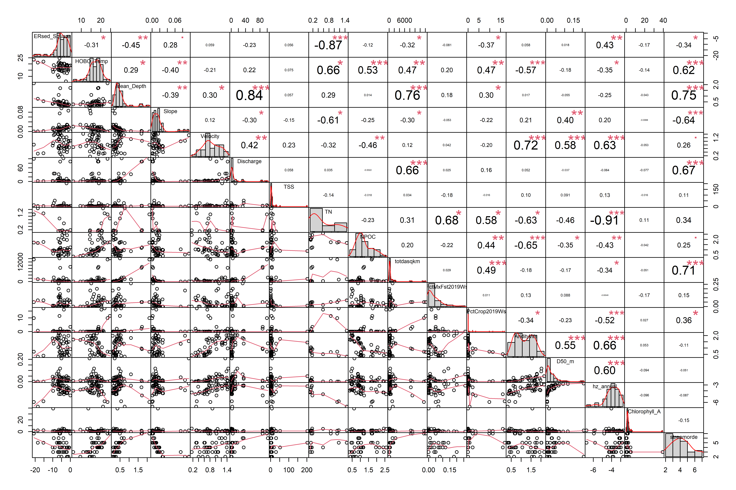
Scatterplot between ERsed and variables

Slide 3
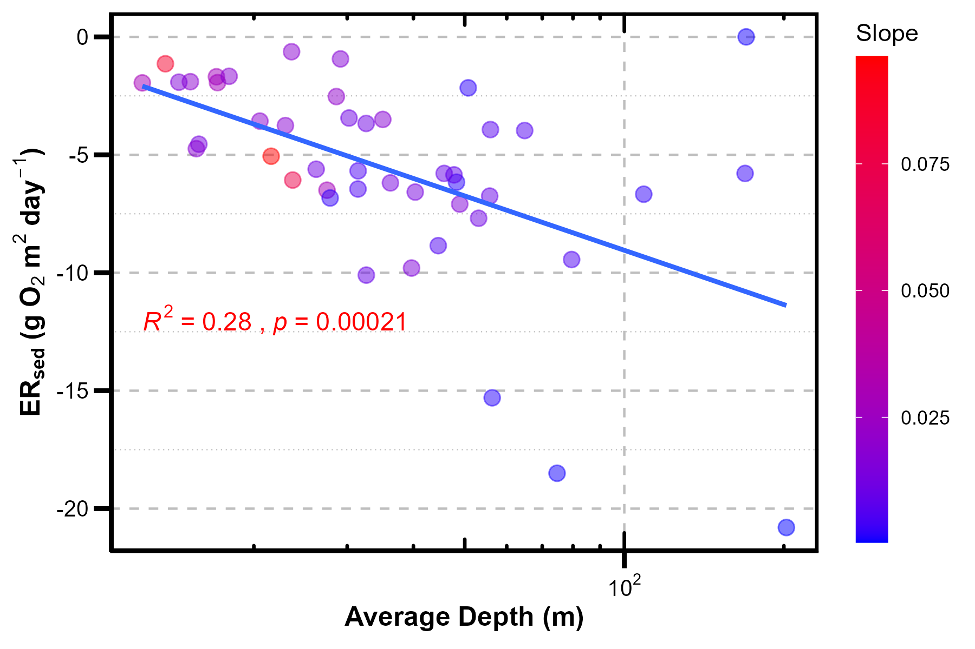
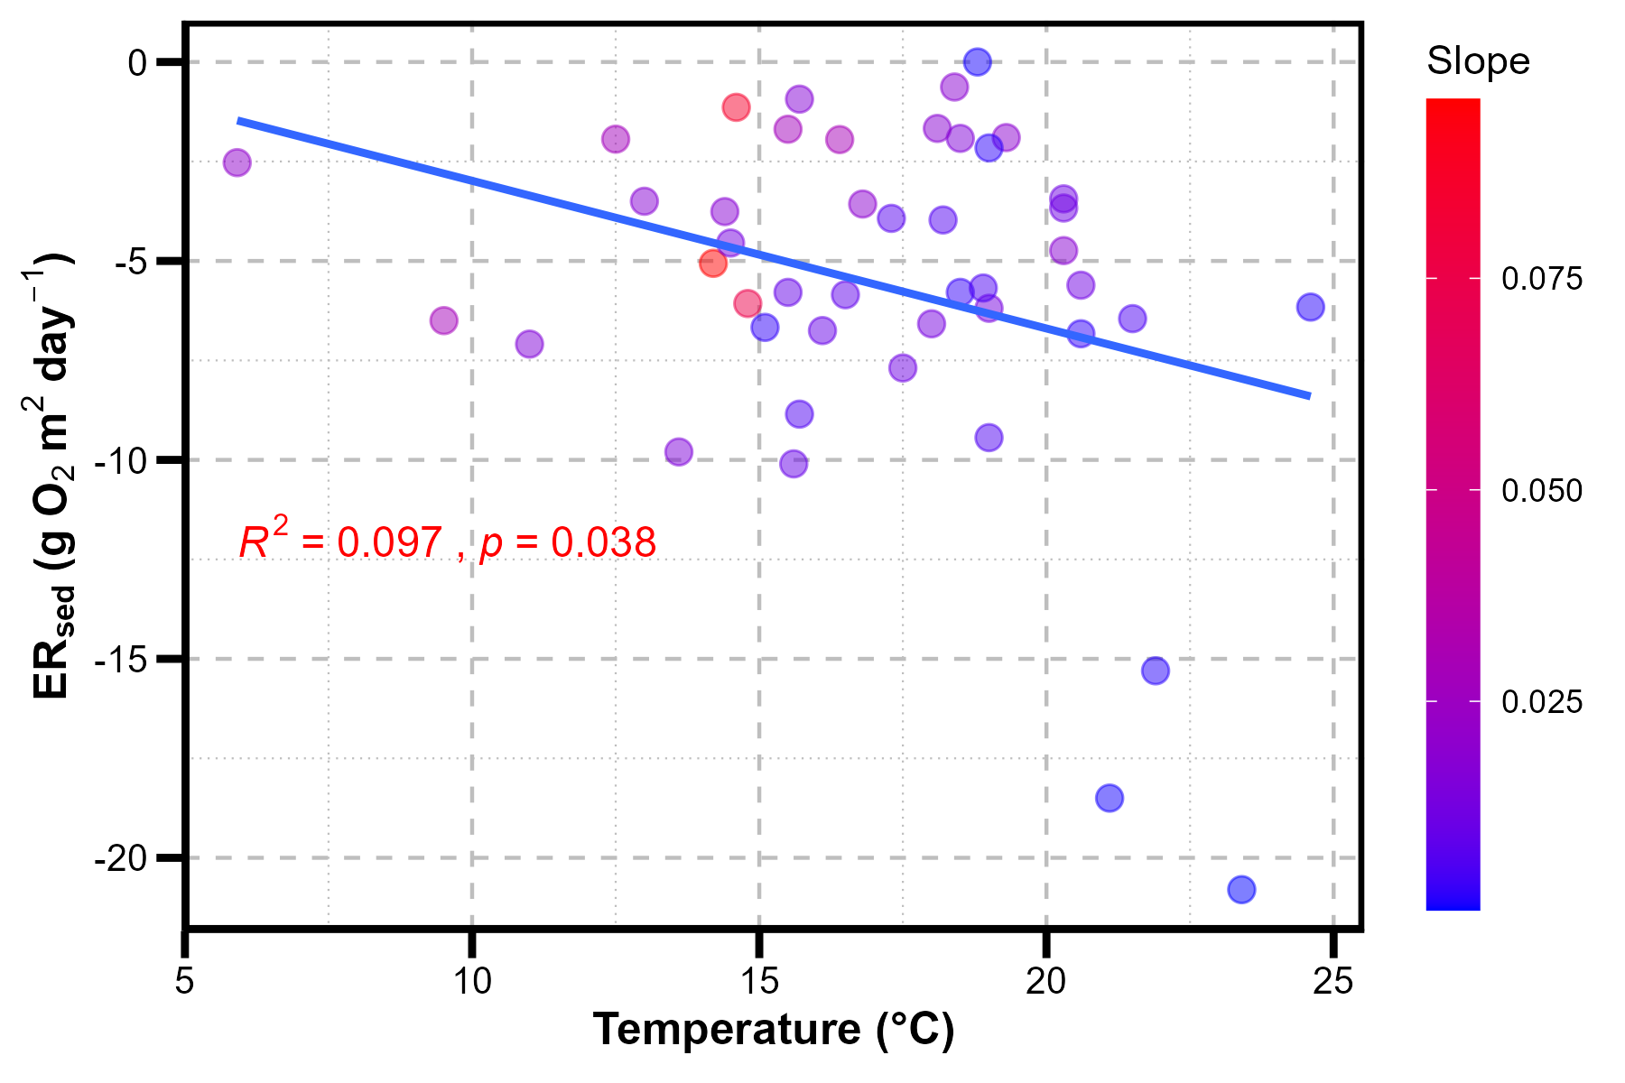
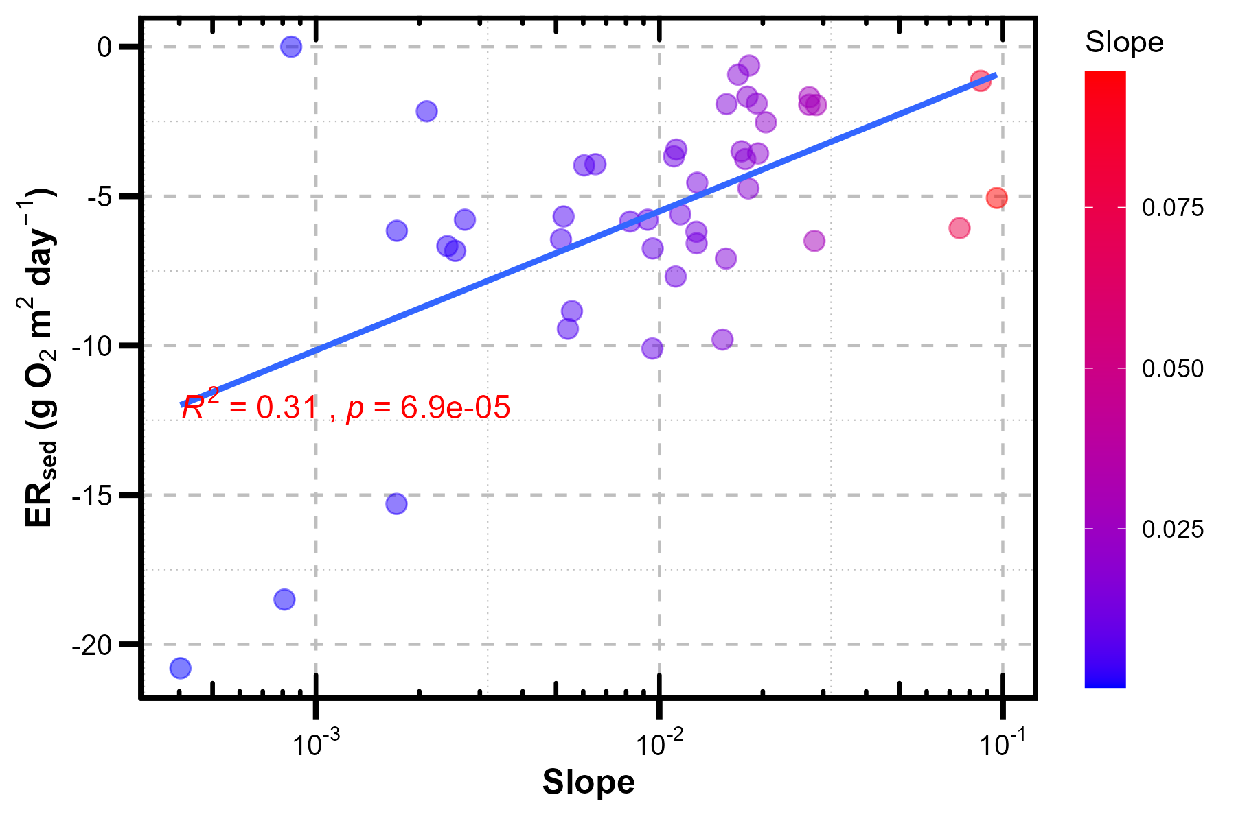
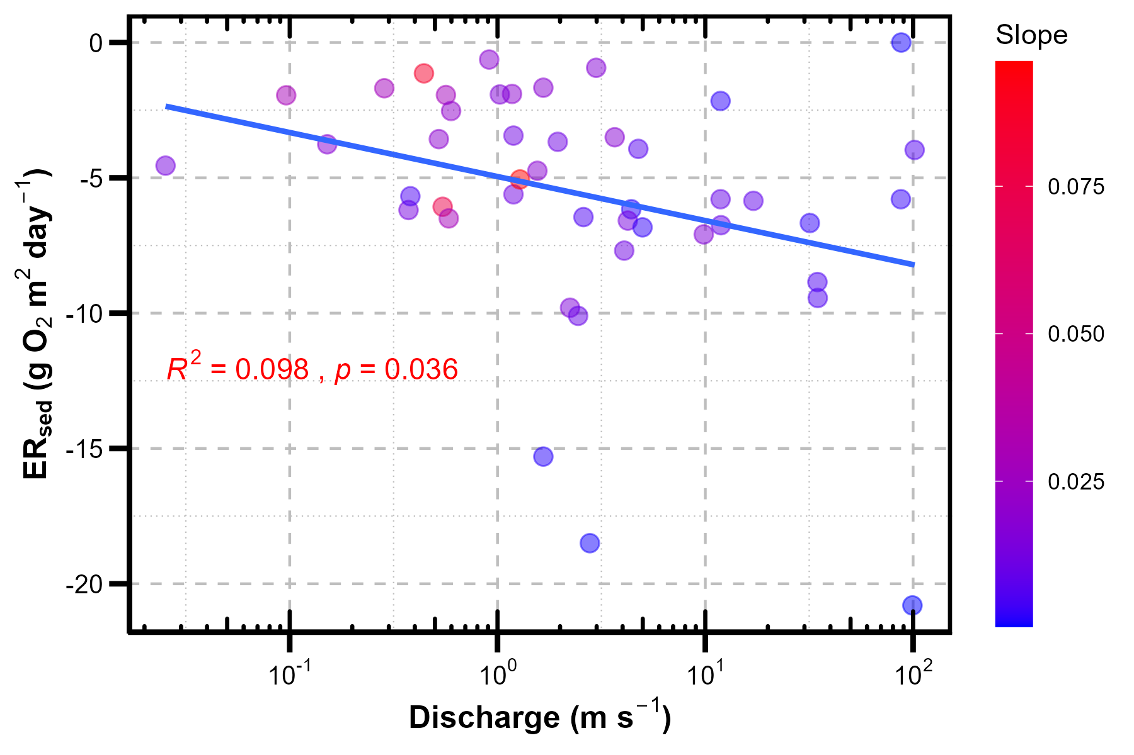
Scatterplot between ERsed and variables

Slide 4
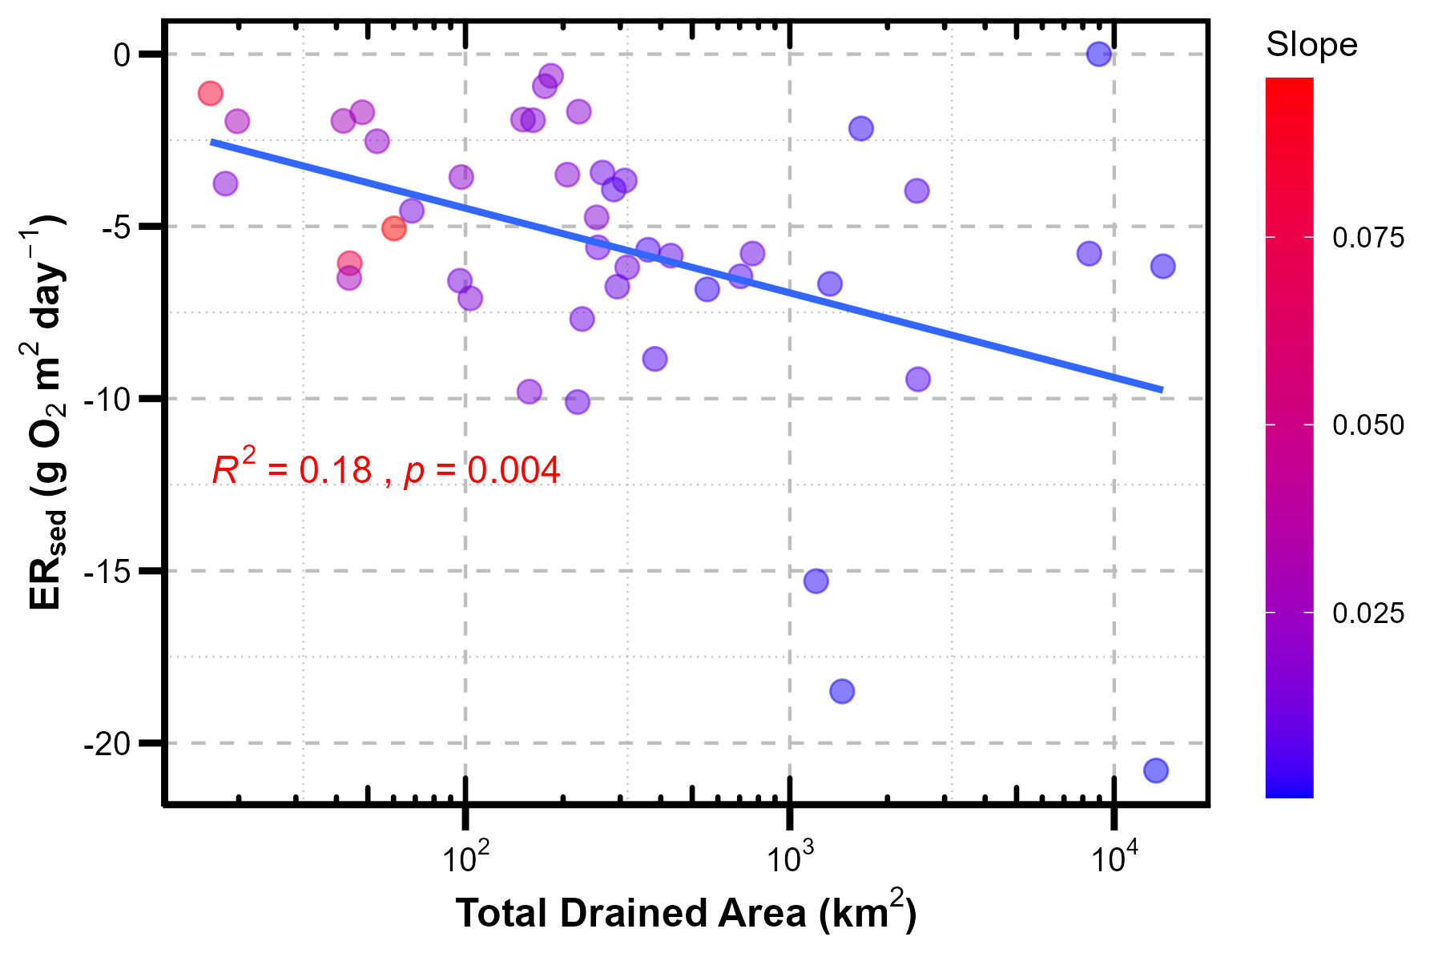
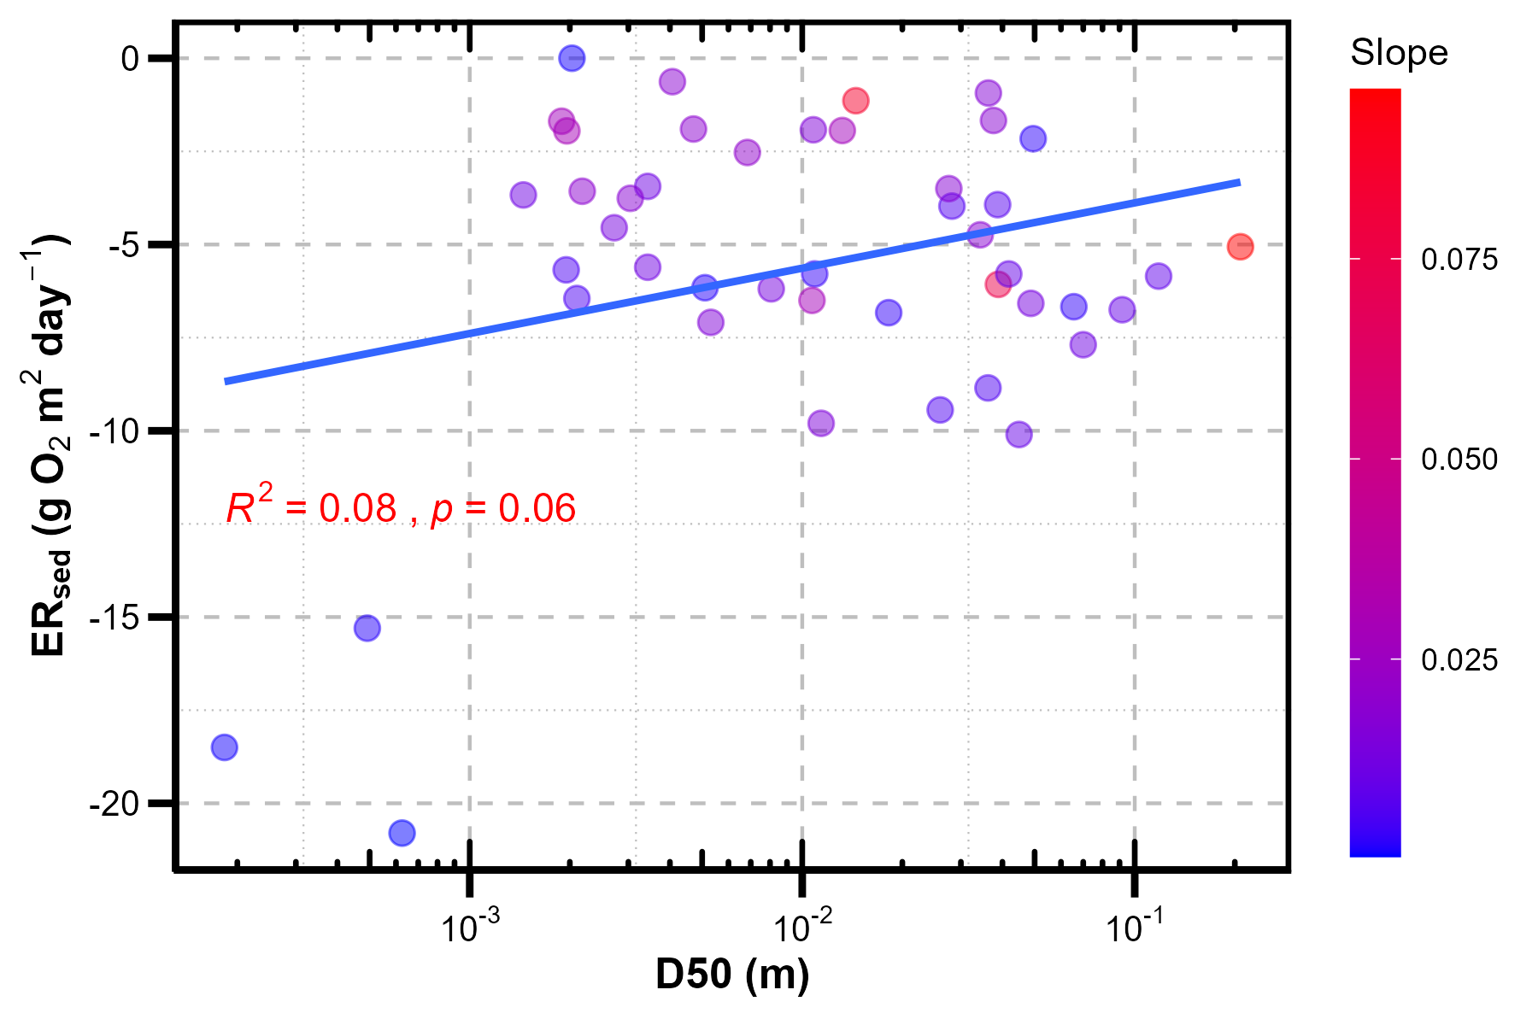
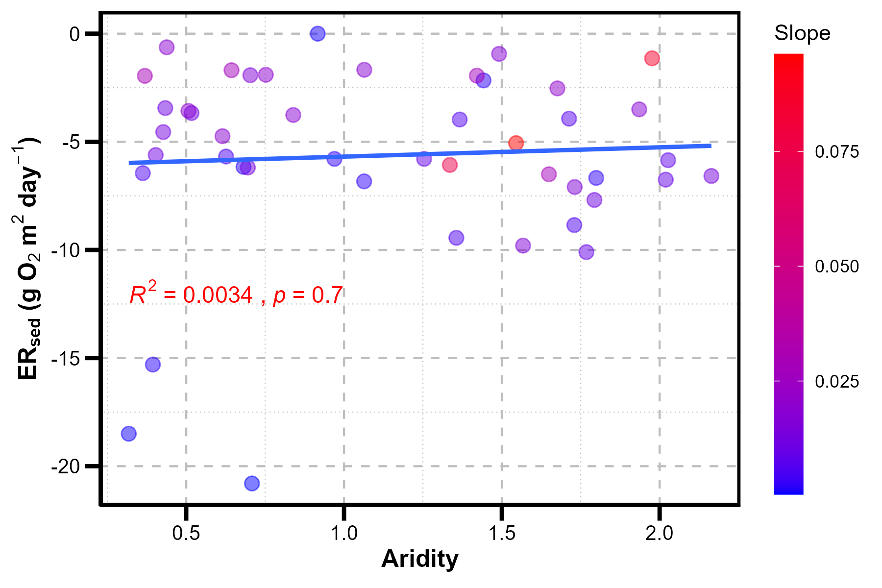
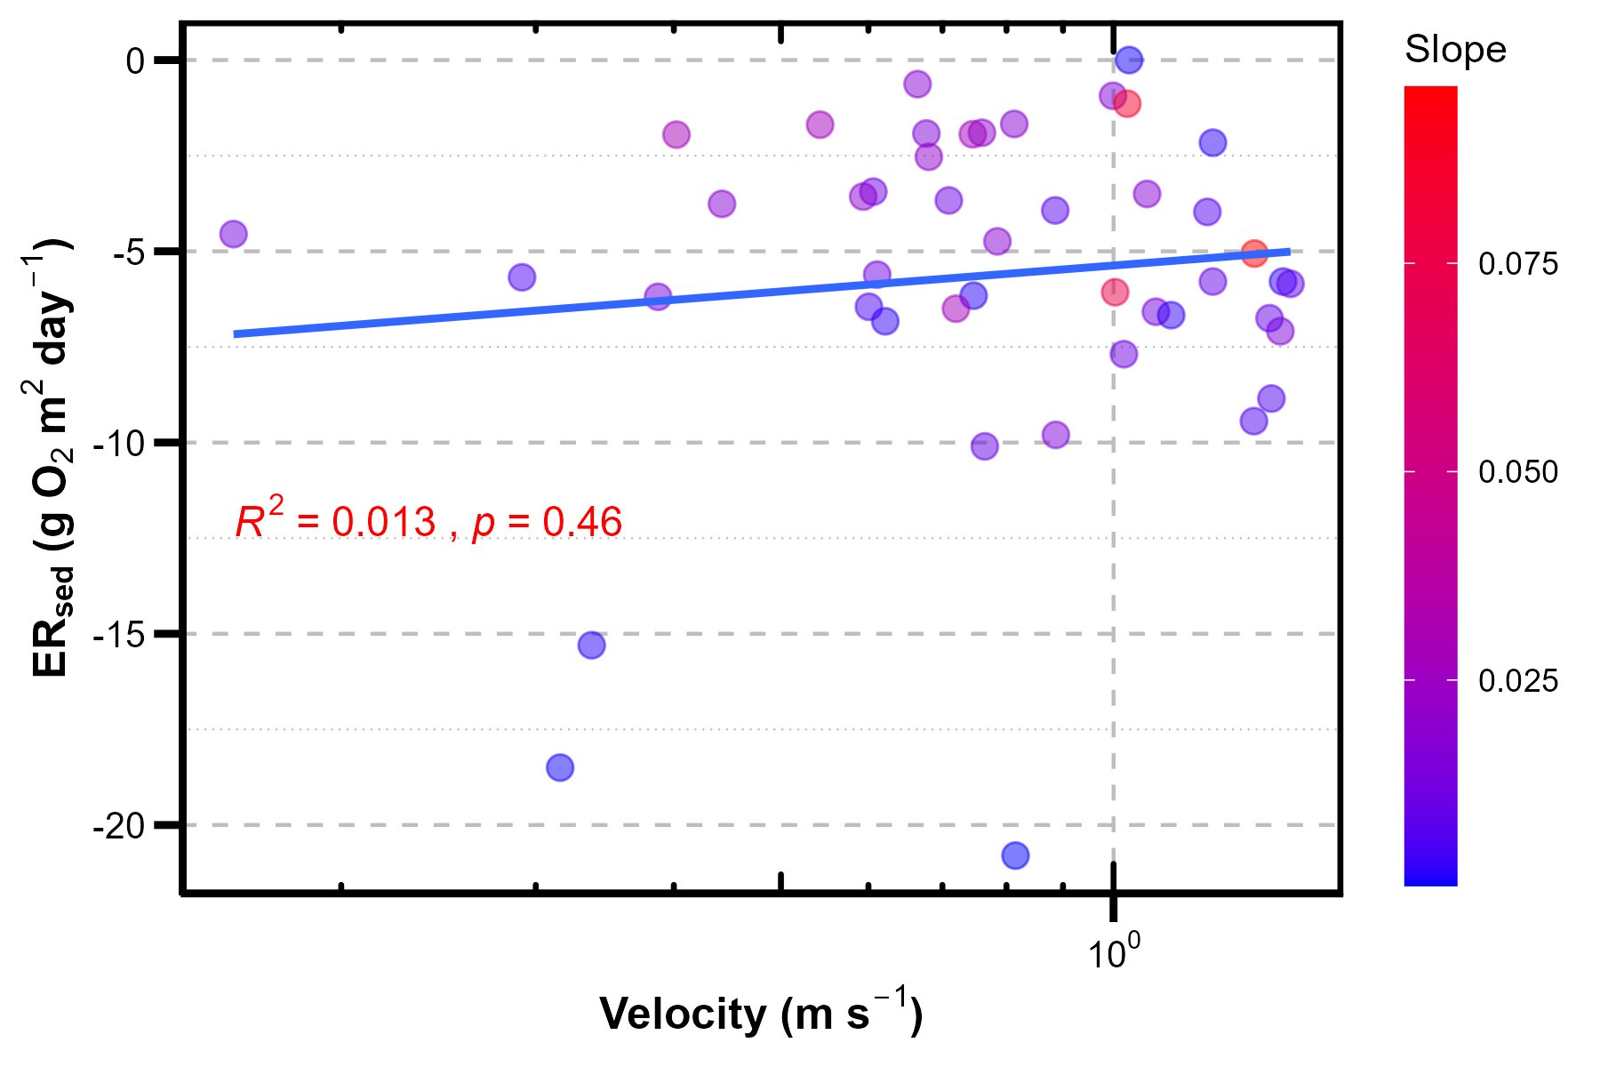
Scatterplot between ERsed and variables

Slide 5
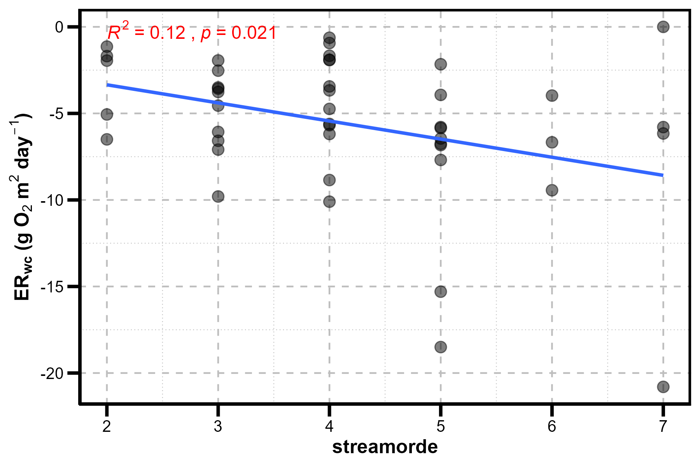
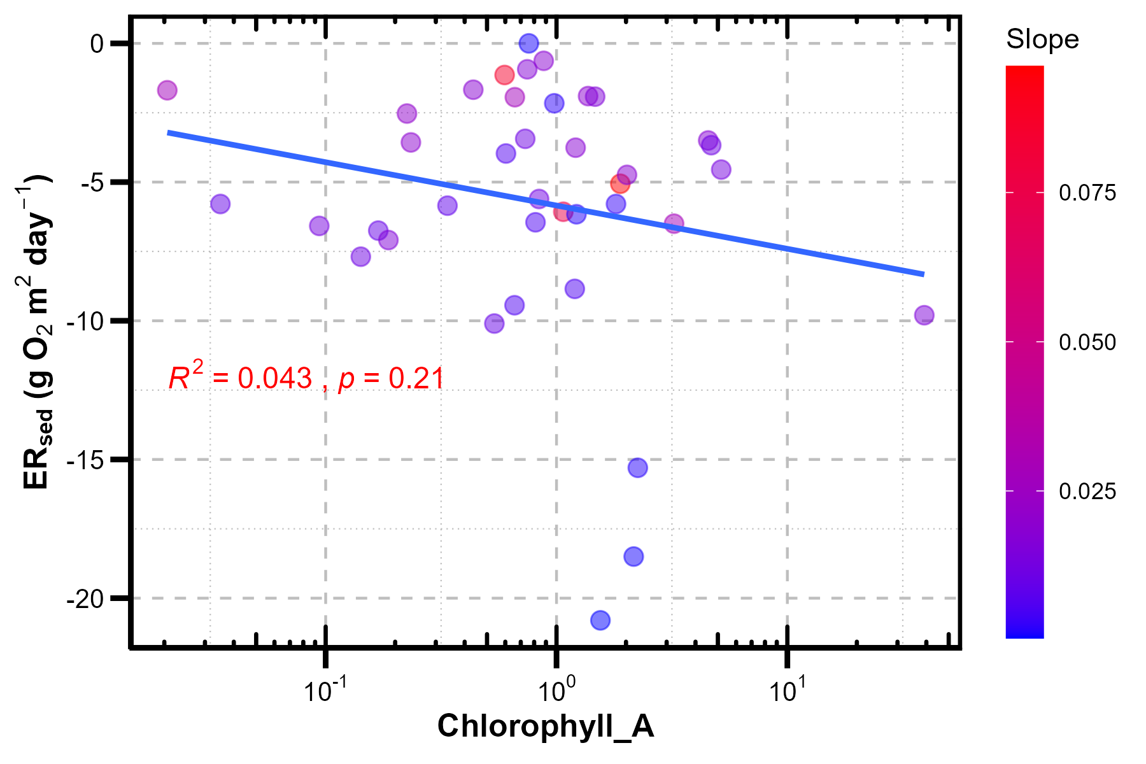
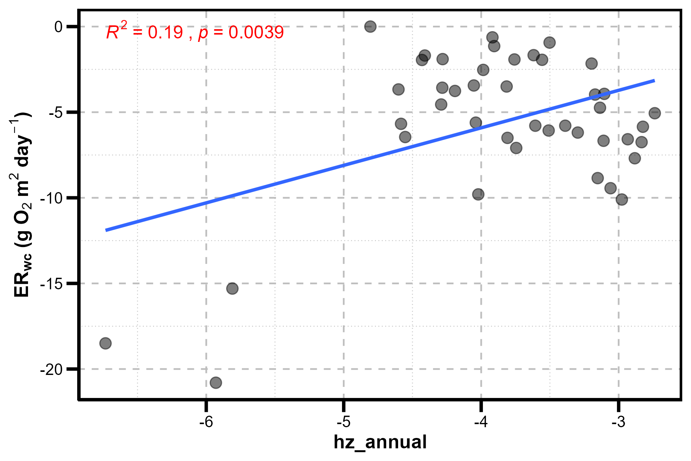
Scatterplot between ERsed and variables

Slide 6
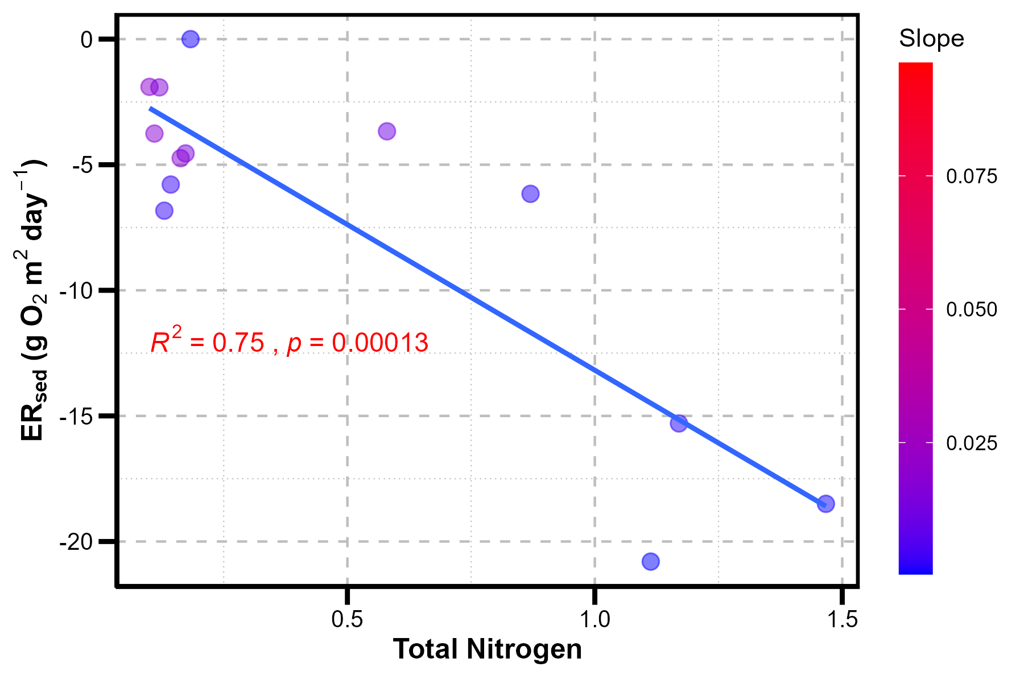
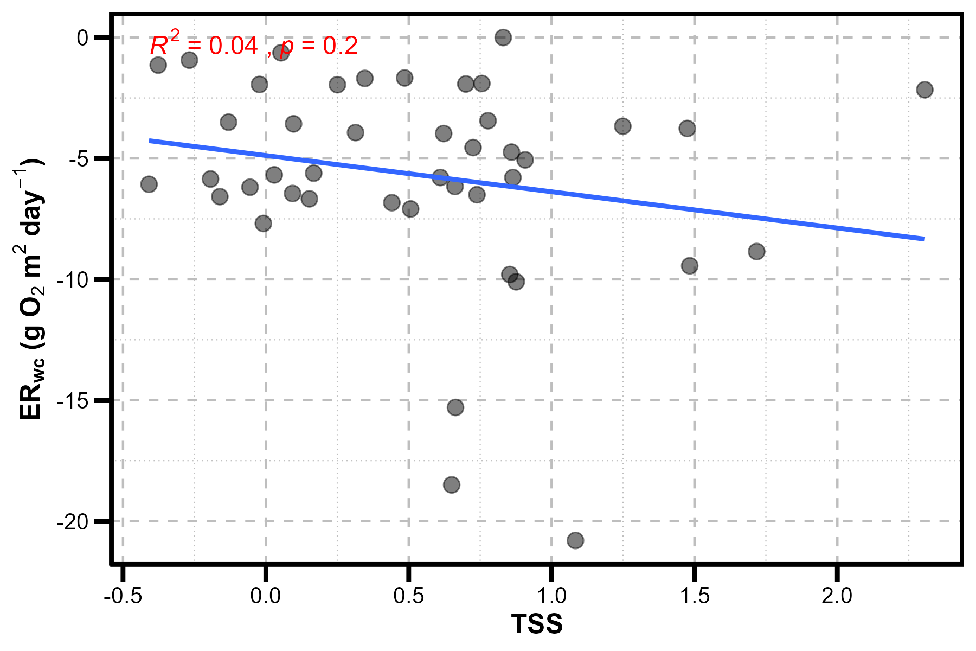
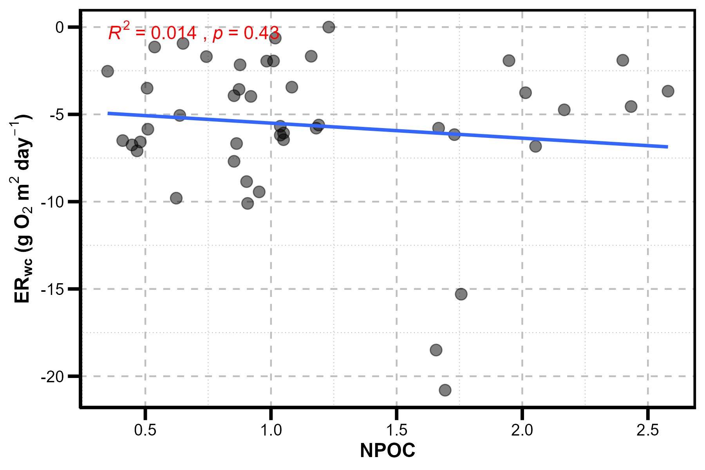
Scatterplot between ERsed and variables

Slide 7
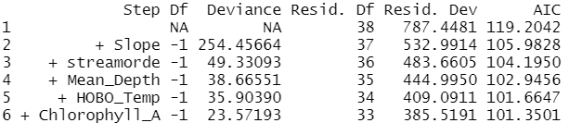
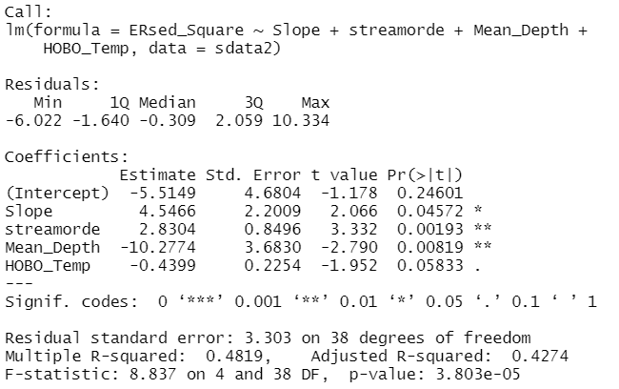
Forward selection -ERsed
Forward stepwise-selected variables (variables to keep in model):
Summary statistics for the lm model fitted using the selected variables(i.e., Slope, streamorde, Mean_Depth, HOBO_Temp)

Slide 8
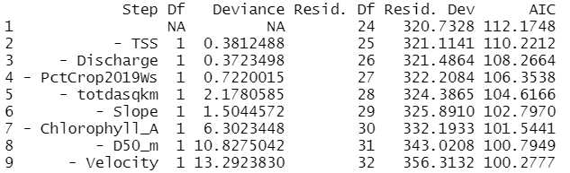
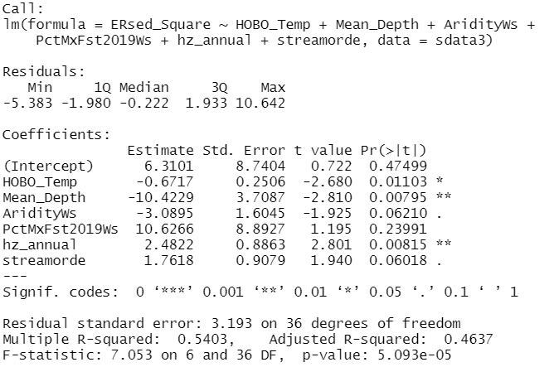
Backward selection - ERsed
Backward stepwise-selected variables (variables to remove in model):
Summary statistics for the lm model fitted using the selected variables(i.e., HOBO_Temp, Mean_Depth, AridityWs, PctMxFst2019Ws, hz_annual, streamorde)

Slide 9
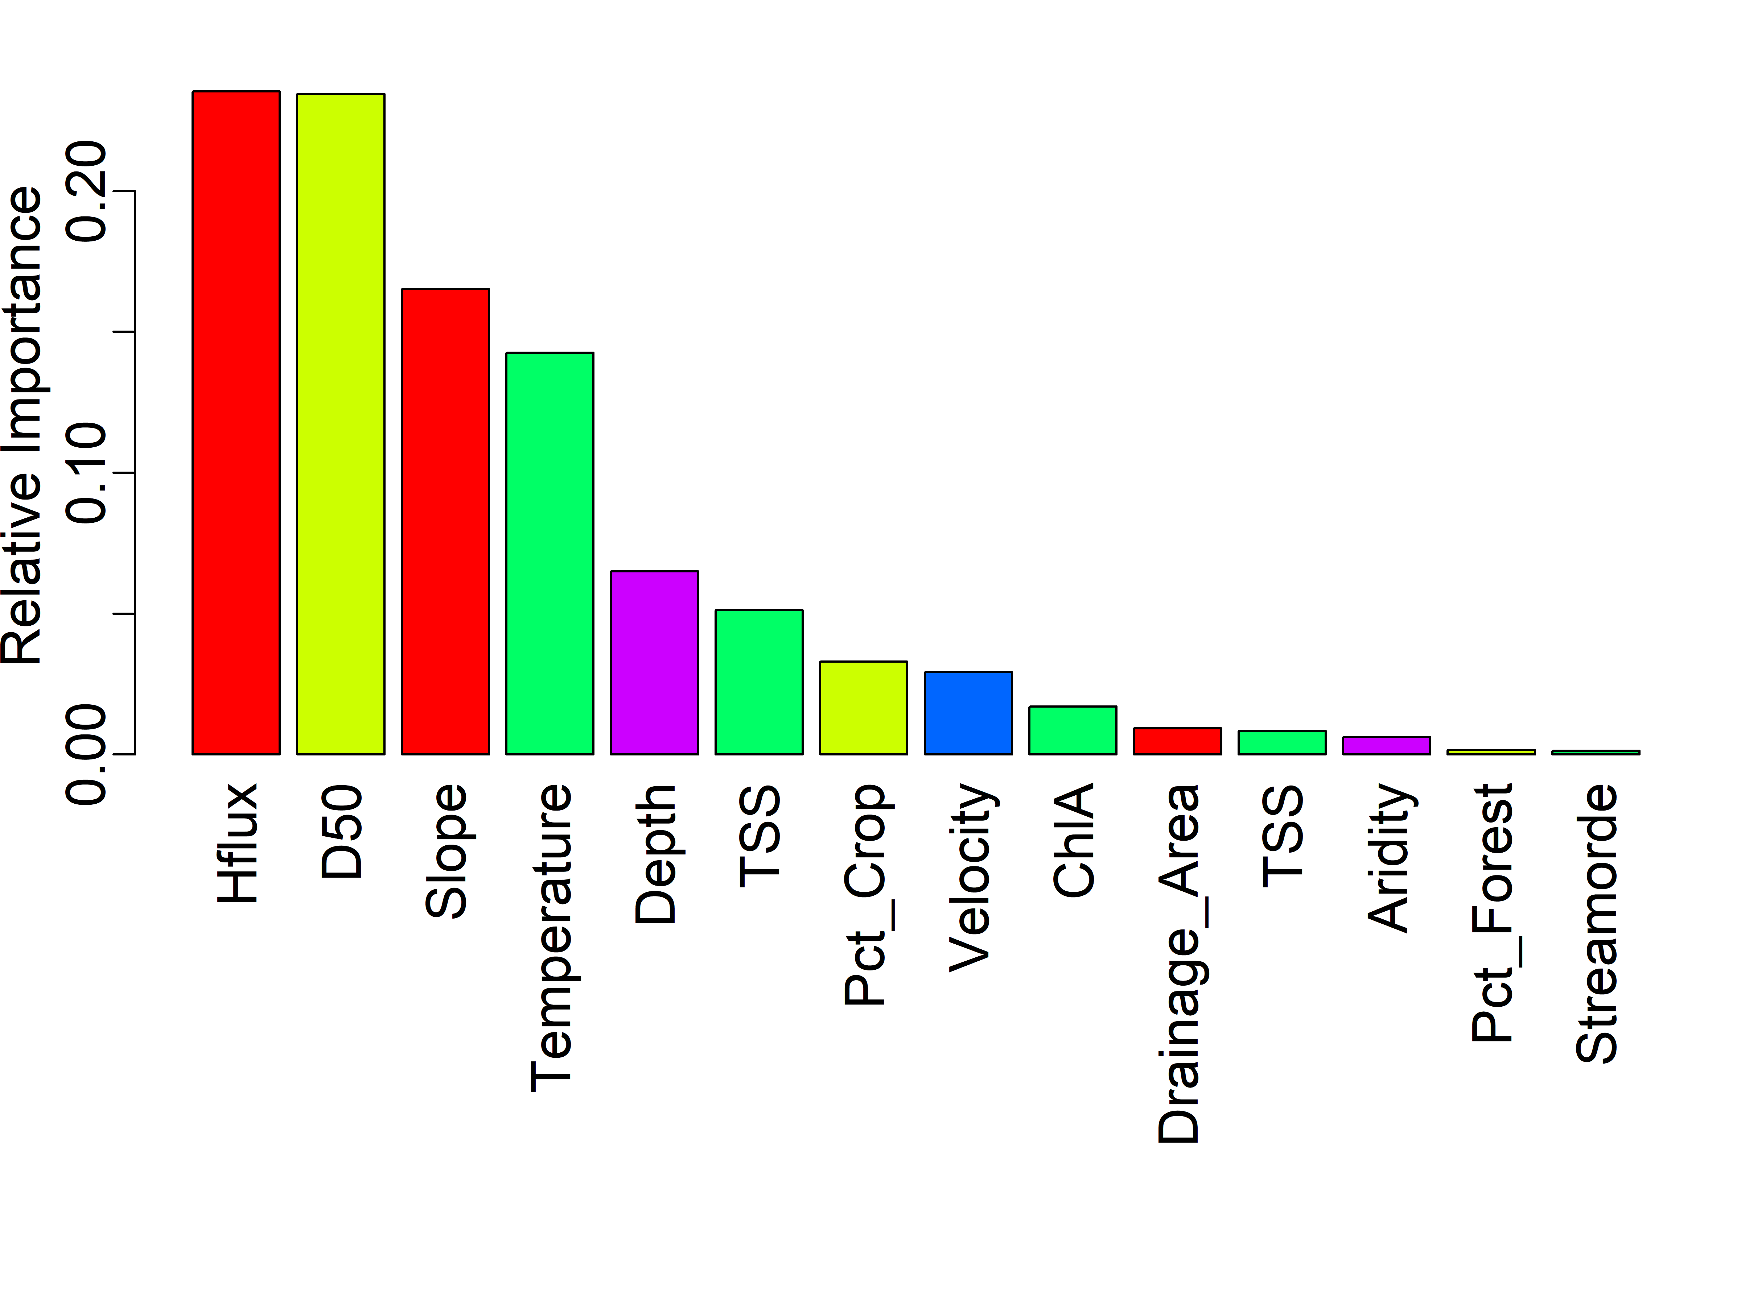
Random Forest(RF) - ERsed
RF was built using the original input variables without log transform (100 trees )
The R2 of the built RF model is about 50%
Variable importance ranking

Slide 10
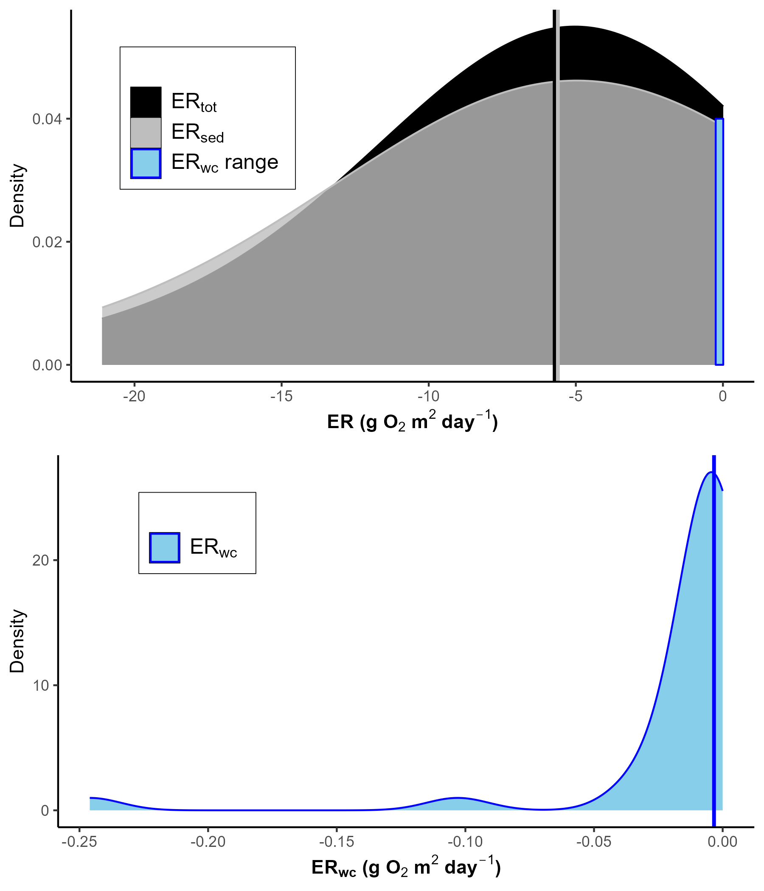
Density plot

